Slide 1
Lab 16

Slide 2
Goal
In todays lab our goal will be to create and understand linked list using java classes

Slide 3
Arrays vs Linked List
We have only really used arrays so to understand Linked Lists we can compare them to arrays
Both are used to store data however linked list allow you store a dynamic amount of data while arrays require a fixed size.
The reason Arrays used a fixed size is that arrays are stored in a continuous section of memory so when an array is declared a block of free space must be found
LinkedList on the other hand are a series of connected nodes where each node has a pointer to the next node, therefore during execution a program just needs to allocate memory for a new node and assign a pointer from a node already on the linked list to it.
In exchange for being dynamic Linked List’s have more overhead

Slide 4
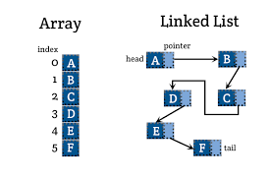
Arrays vs LinkedList
https://www.geeksforgeeks.org/linked-list-vs-array/

Slide 5
Prep
To get started create a new java project for Lab 16 and import the files Lab16Main.java, LinkedList.java and ListNode.java

Slide 6
ListNode
Individual nodes in our linked list are implemented with our ListNode class, each object of the class has two instance variables
A String data which holds the string for Node
A ListNode next which should hold either null or the next node on the list

Slide 7
LinkedList
The provided LinkedList provides a head node which has a null data value
It also has a variable ListNode first and last and an int variable length
The first variable is a pointer to the first node and the last is a pointer to the last node

Slide 8
Append
The first method we need to complete is append
We want to add this new node to the end of our linked list
What we want to do with append is pass a string and then create a new node with that string as an argument
Once we have our node we want to add it to the end of our list, we need to update the next value of our last node, update our last and also update the length to do this

Slide 9
Prepend
The other method we need to implement is prepend, which also takes a string and should create a node with that string to start off
For prepend we want to add our node to the start of our list, however keep in mind our head node is a dummy node so we actually want to insert the new node after the start node
We will have to update the start nodes next value and also the length
If the dummy node was already pointing to another node you will have to make sure you have the node you are prepending to the list point to that node before you change the next value of the dummy node or else you will lose the other node.

Slide 10
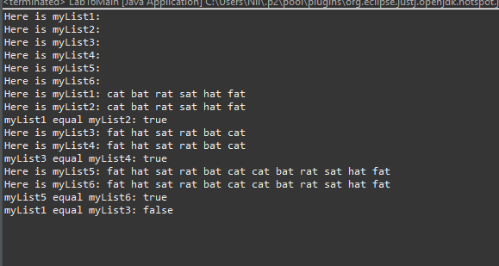
Check
If everything checks out you should get the following output

